Slide 1

World Population Analysis
Presented by: Ujwala Tejaswani Dhanenkula
CONTENTS
INTRODUCTION
PROBLEM STATEMENT
DATASET
KPI’S and VISUALIZATIONS
KEY INSIGHTS
CONCLUSION

Slide 2

INTRODUCTION
The world’s population is constantly evolving, impacting various aspects of society, economy, and the environment. Understanding population trends is crucial for policymakers, businesses, and researchers to make informed decisions about resource allocation, urban planning, healthcare, and economic development.
Through this study, we will explore critical factors influencing population dynamics and their potential implications, helping governments and organizations create data-driven strategies for a more balanced and sustainable future.

Slide 3

PROBLEM STATEMENT
Understanding global population trends is crucial for policymakers, researchers, and businesses to make informed decisions.
This project aims to analyze population data to uncover patterns, growth trends, and demographic distributions across different regions and countries.
Using Power BI, we will create interactive dashboards to visualize key metrics such as population growth rates, density, age distribution, urban vs. rural population, and migration trends.
The objective is to provide data-driven insights that can help in addressing global challenges related to sustainability, infrastructure, and economic development.

Slide 4

DATASET
The dataset contains global population data across years and countries.
It includes key demographic metrics such as:
Country and Capital
Rank
Continent
Year
Population
Growth Rate
Area
Time range: (1970 – 2022)
Data Cleaning & Preprocessing: Handled missing values, duplicates, and inconsistencies before analysis.

Slide 5
KPI’s and VISUALIZATIONS
📊 Key Performance Indicators (KPIs):
Top 7 Largest Countries by Area:
Russia (17.1M km²)
Canada (10.0M km²)
China (9.7M km²)
United States (9.4M km²)
Brazil (8.5M km²)
Australia (7.7M km²)
India (3.3M km²)
Population Distribution by Continent:
Asia: 59.21%
Africa: 17.89%
Europe: 9.32%
North America: 7.53%
South America: 5.48%
Oceania: 0.57%
Global Population: 8.0 billion
Total Land Area: 136.1 million km²
Most Populated Country: China (1.4 billion)
Least Populated Country: Vatican City
Top 5 Populated Countries:
China (1.4B)
India (1.4B)
United States (0.3B)
Indonesia (0.3B)
Pakistan (0.2B)

Slide 6
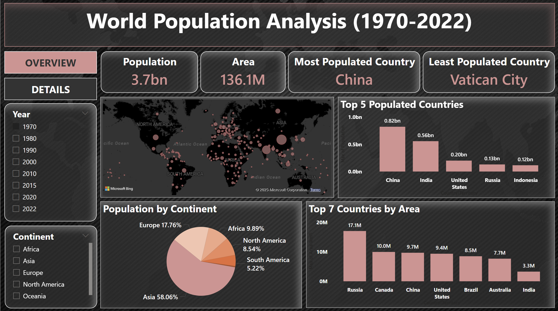

Slide 7
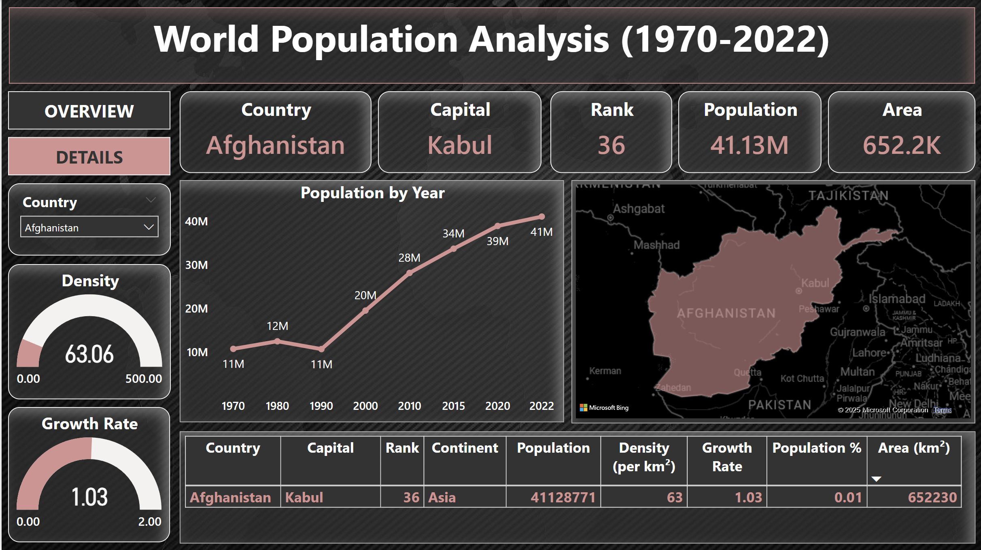

Slide 8
KEY INSIGHTS
Asia dominates global population with nearly 60% of the world's people, while Oceania and South America have the lowest shares.
China and India together hold around 35% of the world’s population, highlighting their dominance in global demographics.
Despite being one of the largest countries by area, Russia has a relatively low population compared to its size, indicating low population density.
Vatican City remains the least populated country, primarily due to its small size and nature as a religious state.
Population growth trends show a steady increase over decades, suggesting continued urbanization and demographic shifts.
The high growth rate in some regions (like Asia and Africa) could lead to challenges in resource management, infrastructure, and employment.
Urbanization trends are visible, with most population-dense regions aligning with major metropolitan areas.

Slide 9
CONCLUSION
China and India dominate in population size, whereas Russia, Canada, and Australia have vast land areas but low population densities, highlighting urbanization and resource distribution challenges.
Rapid population growth increases demand for resources, infrastructure, and economic planning, requiring sustainable development strategies to manage urban expansion, employment, and environmental impact.
Power BI’s interactive dashboards provide valuable insights into demographic trends, helping policymakers, researchers, and businesses make data-driven decisions for a more sustainable future.

Slide 10


